Slide 1
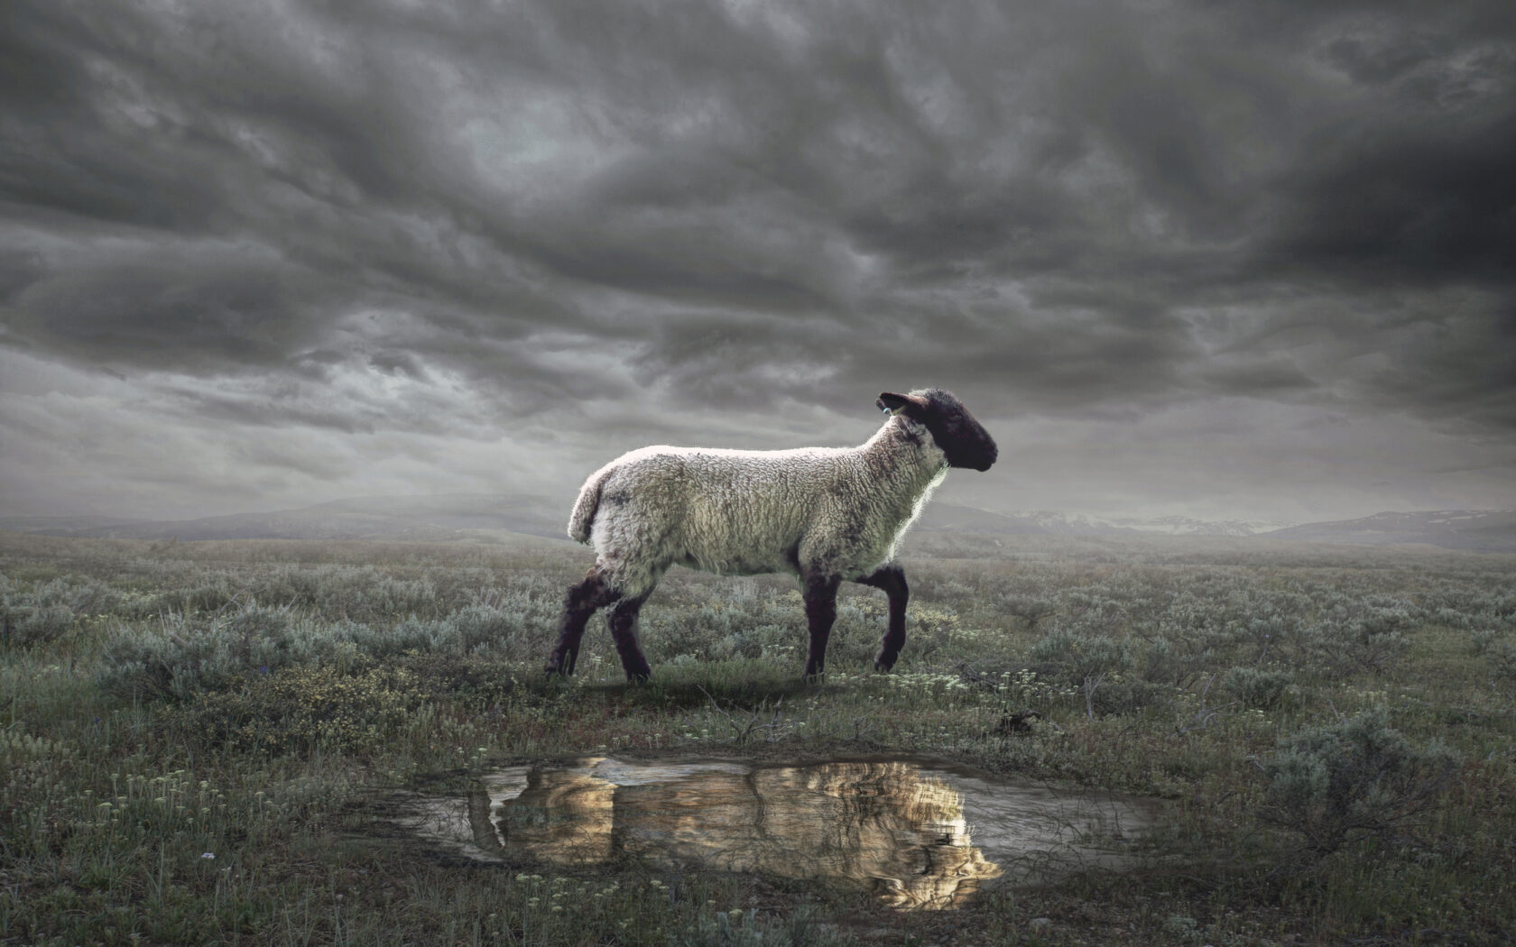
The Revelation
Wednesday Nights
Winter 2023-24

Slide 2
Revelation 17-18
Babylon the Great
Pride & Arrogance
Wealth & Attraction
Seduction & Influence
Promise of Glory
Persecution of Saints
Rome & Beyond
Self-Destructive
Left Desolate
Can we see America in this picture?
What does it mean to “Come out of Babylon” (18:4)?

Slide 3
Overview of Revelation
Earthly Setting (1-3) – Jesus speaks, saints in crisis
Heavenly Setting (4-5) – God reigns; His plan (accomplished by the Lamb) will be carried out
Dramatic Cycles Picturing God’s Action:
Seven Seals (6-8) – Judgment (Saints protected)
Seven Trumpets (8-11) – Judgment (Saints testify)
Seven Signs (12-15) – Dragon & Beast vs. Saints
Seven Bowls (15-16) – Total wrath poured out
Final Showdowns:
Fall of Babylon (17-19) – and Bride readies herself
Defeat of Satan (19-20) – Christ conquers & reigns
New Jerusalem (21-22) – naught unclean will enter

Slide 4
Revelation 19
Read (listen to) the chapter.
What storylines, themes, symbols, ideas, etc. are starting to culminate in ch.19?

Slide 5
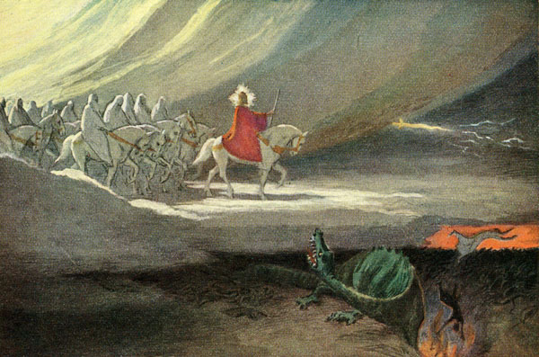
Rider on White Horse (Rev. 19)

Slide 6
Revelation 19: Closer Look
Hallelujah, Worship God (1-10)
“Hallelujah!” (1,3,4,6) – Praise Yahweh!
“for he has judged” (2) – see 14:6-7, the “eternal gospel” of God’s just rule
elders & living creatures (4) – ch.4-5
“Marriage of the Lamb has come” (7-8) – faithful Bride, clothed in righteous deeds
“testimony of Jesus” (9-10) – it’s about Him, and no one else

Slide 7
Revelation 19: Closer Look
Tread the Winepress (11-21)
The Rider on the White Horse (11-16)
What is His name? (11,13,16, also v.12)
He conquers, but how? (13,15; 12:11)
He rules nations and kings (15-16)
Another feast! (17-18) – for the birds, see Ezekiel 39:17-20
The Beast (13:1), False Prophet (13:11, 16:13) and all with them are slain (19-21)

Slide 8
Revelation 20
Read (listen to) the chapter.
See the drama unfold, the basic plot points of the story.

Slide 9
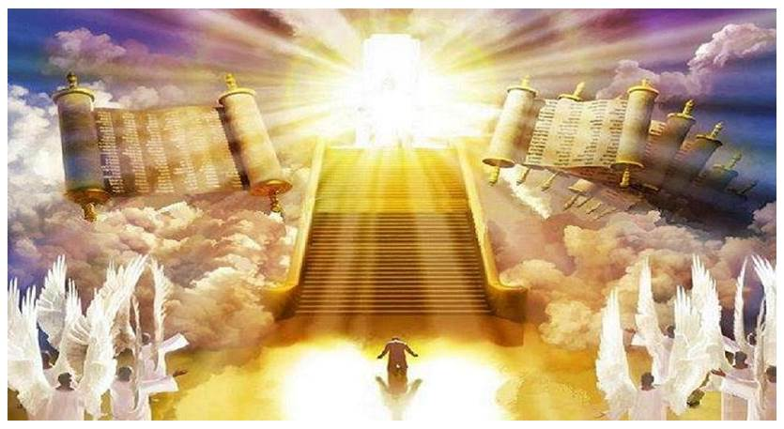
Great White Throne (Rev. 20)

Slide 10
Revelation 20: Closer Look
The Dragon’s Fall (1-6)
Satan Bound (1-3) – Defeated, limited, doomed (Mk 3:27; Lk 10:18; Jn 12:31)
for 1,000 years (2,3,4,6) – a long (complete?) time (Ps 50:10; 2 Pet 3:8)
Reign of the Beheaded (4) – the faithful witnesses conquer (11:11-12; 12:10-11)
“First resurrection” (5-6) - Rev 11:11 + Jn 11:35; or Jn 5:26 + Rom 6:4)

Slide 11
Revelation 20: Closer Look
One Final Rebellion (7-10)
To deceive the nations (8) – 2 Thess 2:11-12; Rom 1:18, 24, 26, 28
Gog & Magog (8-9) – from Ezekiel 38-39
After return & restoration (Ez 34-37)
Biggest, baddest army imaginable
God brings it to Judah to slay them
“Once I’ve restored you, even if the nations do their worst, I will protect/deliver you.”
Lake of Fire (10) – After final attempt, Satan joins beast in eternal destruction

Slide 12
Revelation 20: Closer Look
Great White Throne (11-15)
Him who was seated on it (11-12)
Back to ch. 5 (heavenly council)
Holy, transcendent (earth/sky flee)
Sits for judgment (books opened)
Holds each one accountable
Knows who are His (3:5; 13:8; 17:8)
Death & Hades (13-5) – ”the last enemy to be conquered is death” (1 Cor 15:26)

Slide 13
Reflections on Rev. 19-20
What perspective do these chapters give us and how does it shape our lives?

Slide 14
The Revelation
Next Week (2/28)
12. ch.21-22: New Jerusalem

