Slide 1
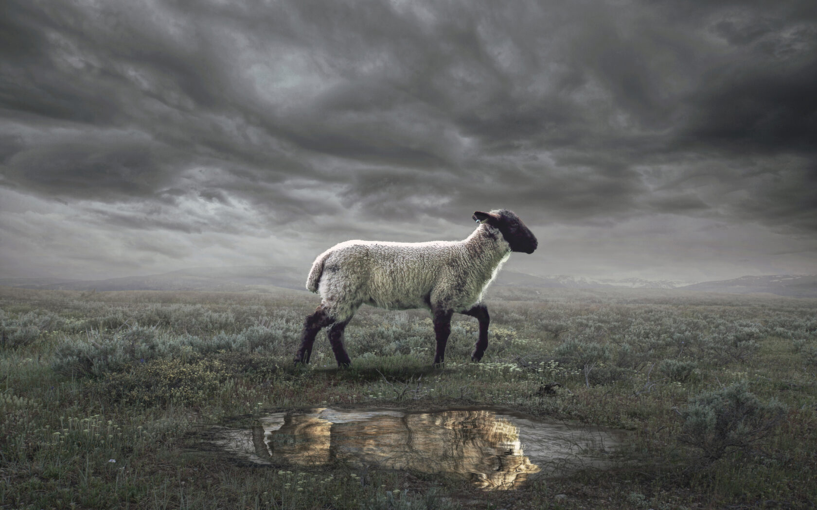
The Revelation
Wednesday Nights
Winter 2023-24

Slide 2
Overview: Revelation 1-11
Introduction to the vision (1-3)
Glorified Son of Man among the ____________ (1)
7 churches charged to “hear” & “________” (2-3)
lampstands
conquers
Act I of the Vision (4-11)
God on throne, praised by His heavenly court (4)
Slain _______ is worthy to open the _________ (5)
Lamb
scroll
6 ______ – heaven’s judgments on earth (6)
Interlude: God’s people _________ (7)
7th ____ – silence in heaven → _________ (8)
6 _________ – God’s wrath on earth (8-9)
Interlude: John’s _____, church’s _______ (10-11)
7th _________ – eternal kingdom come (11)
seals
trumpets
call
sealed
witness
seal
trumpet
trumpets

Slide 3
Revelation 12
Read (listen to) the chapter.
See the drama play out and get the basic storyline.

Slide 4
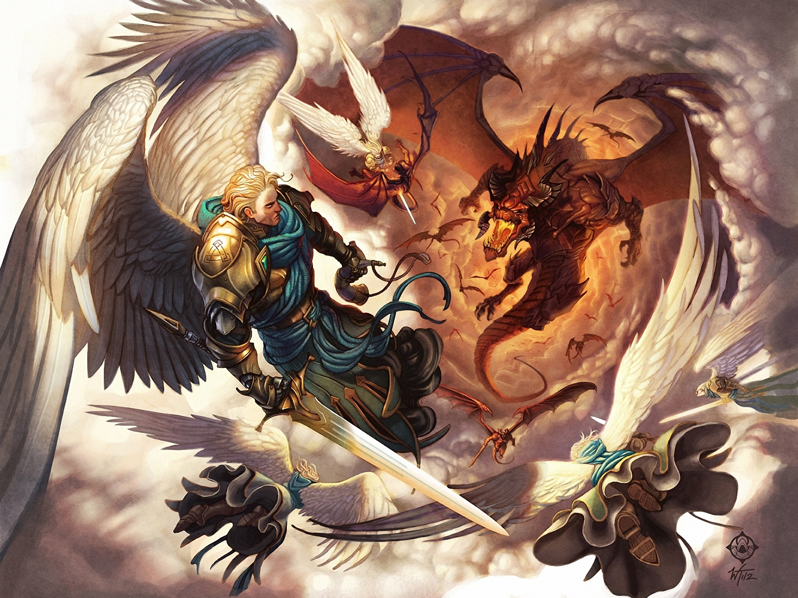
War in Heaven (Rev. 12)

Slide 5
Making sense of Revelation 12
Identify key points – anchors in this text
Which figures are identified clearly?
What are the clear plot points of the drama?
See biblical patterns – from OT and NT
What images/elements from this story remind you of a previous Bible story?
Put it in context – of the Revelation
What themes from Revelation 1-11 are being sounded again in chapter 12?
Consider audience – 1st century Asia
What would this mean for the 7 churches?

Slide 6
War in Heaven & Earth (Rev 12)
Woman v. Dragon (1-6)
Woman = Humanity (perhaps also Israel)
Devil tries to thwart God’s plan; Christ overcomes (death, resurrection, ascension)
Michael v. Dragon (7-12)
Christ victory deals mortal blow to devil
Those who follow Lamb conquer with Him
Dragon v. Offspring (13-17)
Devil rages because he’s been defeated
God protects & provides His people as the devil makes war against them

Slide 7
Revelation 13
Read (listen to) the chapter.
How does the dragon use the beasts to do his work?

Slide 8
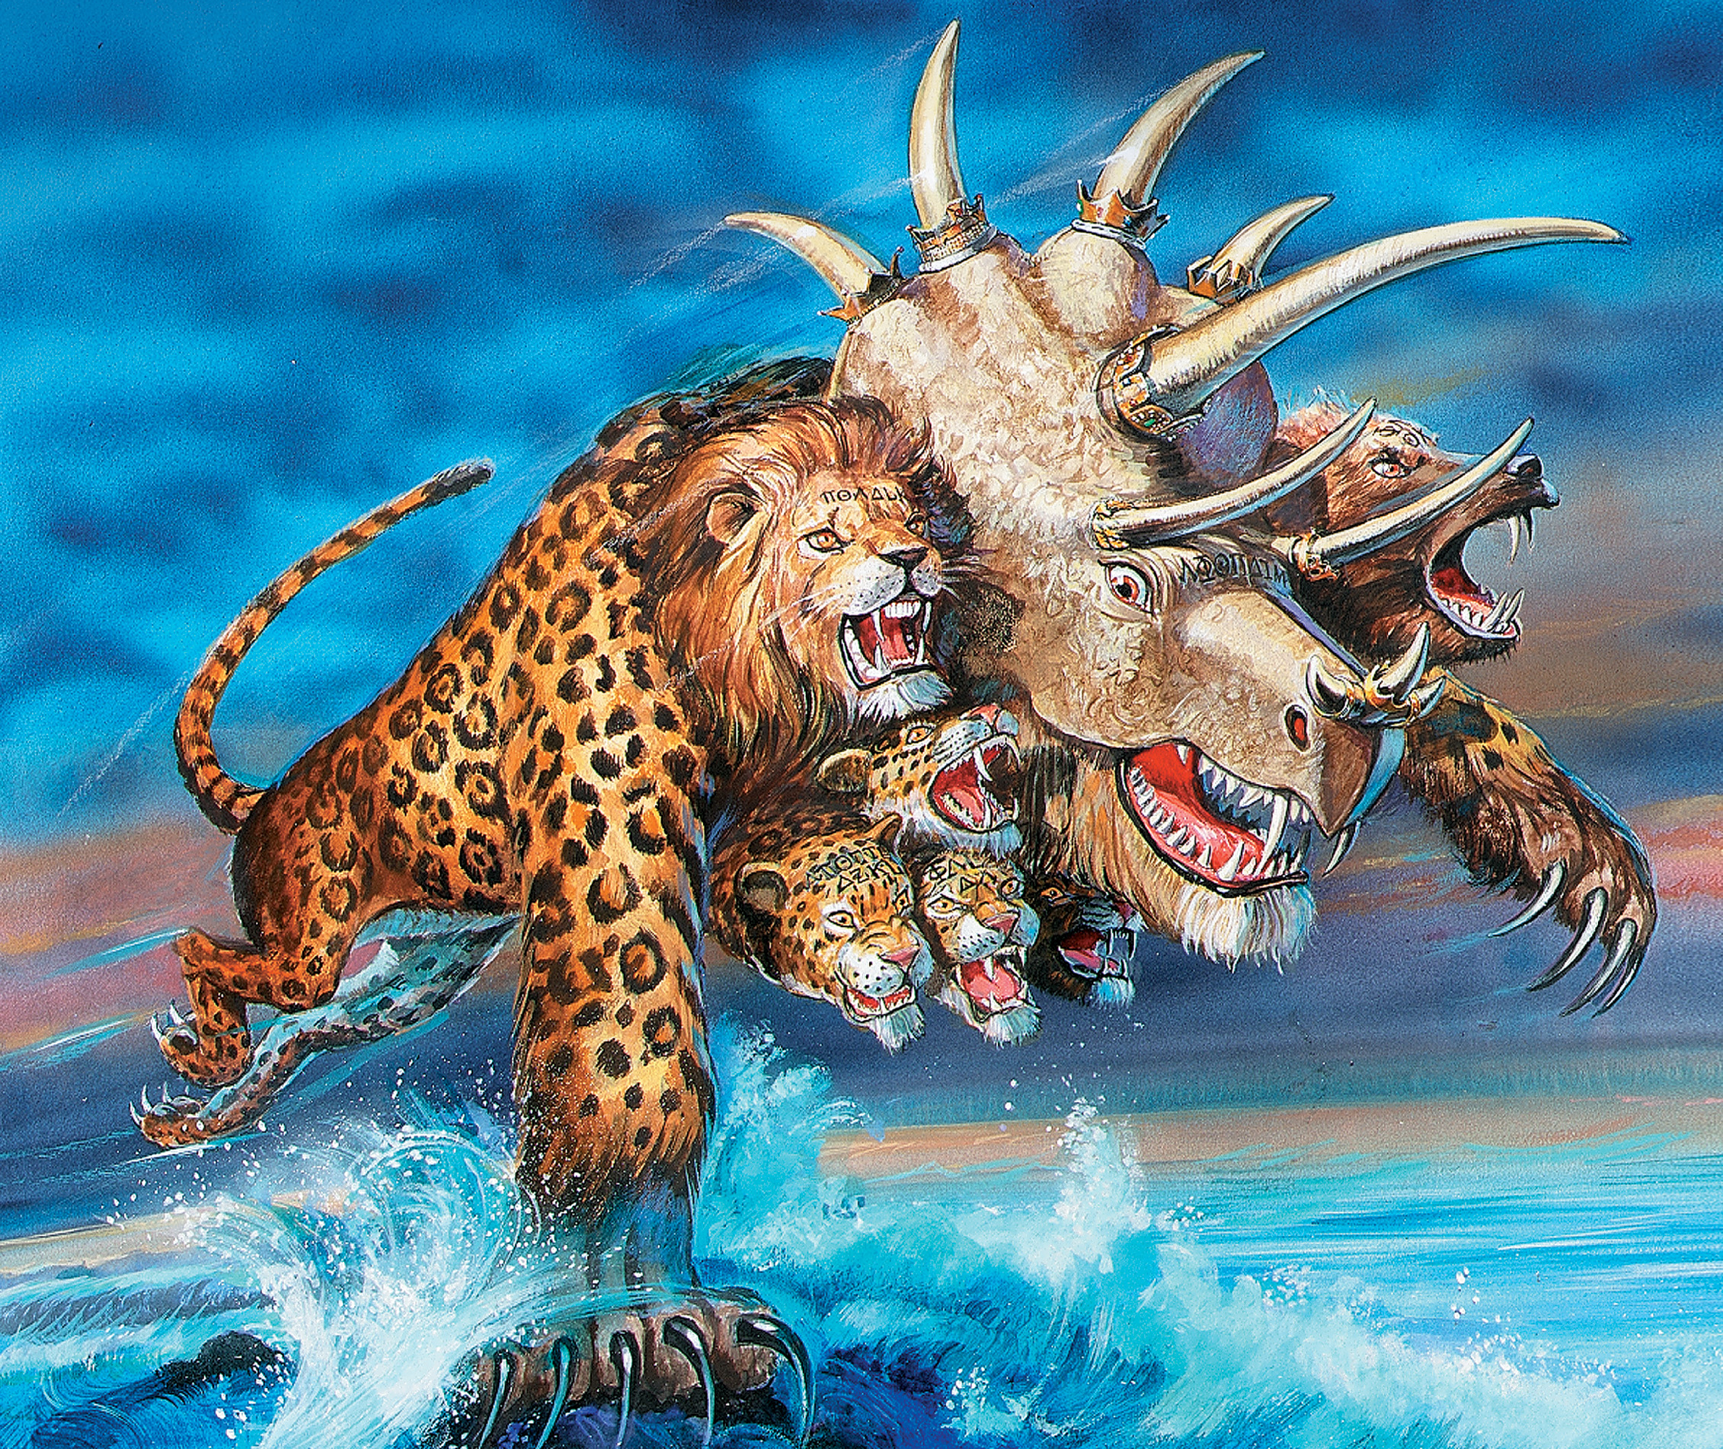
Beasts Rising (Rev. 13)

Slide 9
Making sense of Revelation 13
See biblical patterns – from OT / NT
Daniel 7 - beasts as world empires
Resembles all, especially the 4th (Rome)
See in context – continuing the story
How does the dragon use the beast?
How is the beast a counterfeit Lamb?
What tactics does the earth beast use to make people worship the sea beast?

Slide 10
Main Points of Revelation 13
The beast is the empire (Rome, then any other) which exalts itself in pride, and persecutes God’s people.
The beast (empire) set itself up as god, to the diabolical end that honor, trust, and adoration are given to men and not to God.
Beasts (nations) use deception, force, economic pressure to achieve conformity.

Slide 11
Reflections on Rev. 12-13
What does all of this say about our role in the cosmic war enveloping heaven and earth?

Slide 12
The Revelation
Next Week (2/7)
9. chapters 14-16: Seven Bowls

