Slide 1
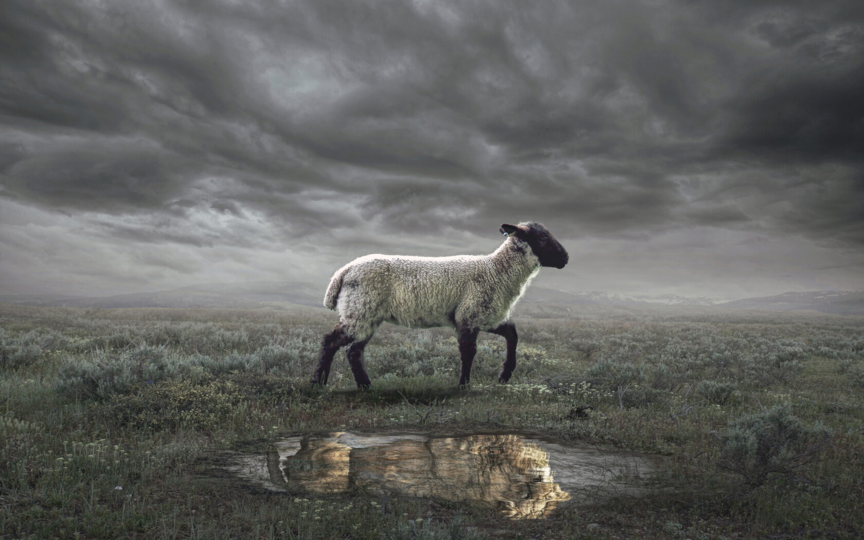
The Revelation
Wednesday Nights
Winter 2023-24

Slide 2
Overview of Revelation
Earthly Setting (1-3) – Jesus speaks, saints in crisis
Heavenly Setting (4-5) – God reigns; His plan (accomplished by the Lamb) will be carried out
Dramatic Cycles Picturing God’s Action:
Seven Seals (6-8) – Judgment (Saints protected)
Seven Trumpets (8-11) – Judgment (Saints testify)
Seven Signs (12-15) – Dragon & Beast vs. Saints
Seven Bowls (15-16) – Total wrath poured out
Final Showdowns:
Fall of Babylon (17-19) – and Bride readies herself
Defeat of Satan (19-20) – Christ conquers & reigns
New Jerusalem (21-22) – naught unclean will enter

Slide 3
Revelation 21 – 22
Read (listen to) the chapters.
Picture the vision in your mind, let it captivate your imagination.
What is the final note(s) sounded in this symphony? What does that say about the book?

Slide 4
Making sense of Rev. 21-22
See biblical patterns
What passages, stories, images from the Bible find their culmination in this vision?
New creation, garden city, tree of life
Tabernacle, temple, God dwells with man
Temple fulfilled, water flows out (Ez.40-48)
Water of life (John 4, John 7)
City of God, wealth of nations (Isaiah 60)
Twelve tribes + twelve apostles
“They will reign forever” (2 Sam 7, Daniel 7)
“It is done!” Grand conclusion of God’s work

Slide 5
Making sense of Rev. 21-22
See in context
Contrast New Jerusalem with Babylon
Bride/Wife of the Lamb (vs. the harlot)
High mountain (21:10) vs. wilderness (17:3)
Adorned for husband (vs. gold, jewels, etc.)
Water of life (vs. the cup of impurities)
Kings bring glory (vs. fornicating with kings)
Wealth is a blessing to the world
Nothing unclean, detestable, false
Name of God/Lamb on their foreheads
They will reign forever and ever

Slide 6
Making sense of Rev. 21-22
Original Readers
What promises were made to the seven churches in ch.2-3?
Eat of the tree of life (2:7)
Give you the crown of life (2:10)
Hidden manna, white stone (2:17)
Authority of the nations; morning star (2:27)
Clothed in white; name not blotted (3:5)
Pillar in the temple of God; new name (3:12)
Grant him to sit on my throne (3:21)

Slide 7
Reflections on Rev. 21-22
How do we “keep the words” of the Book of Revelation?

Slide 8
The Revelation
Next : Psalms on Sundays
in Auditorium on Wednesdays

