Slide 1
Exodus 3-4 Be Delivered

Slide 2
In what ways do we see similarities between Moses and Christ through birth and early years?

Slide 3
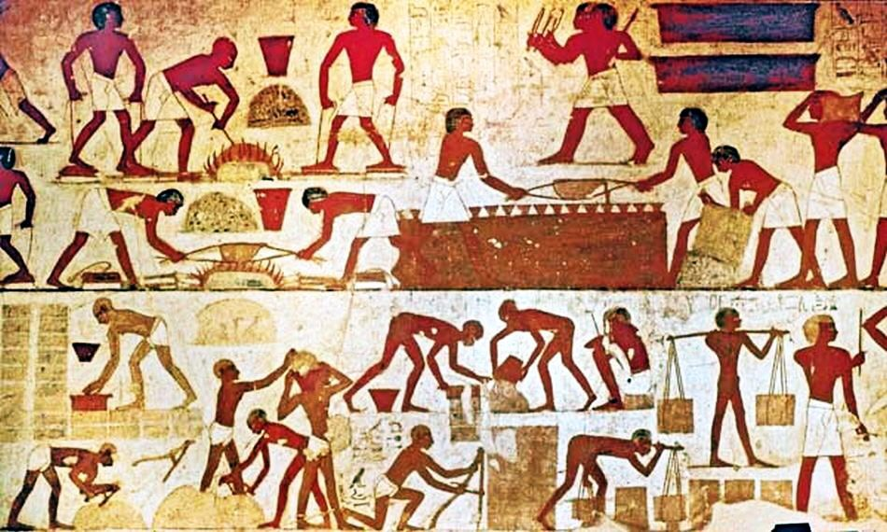

Slide 4
⁵“And you shall make response before the Lord your God, ‘A wandering Aramean was my father. And he went down into Egypt and sojourned there, few in number, and there he became a nation, great, mighty, and populous. ⁶And the Egyptians treated us harshly and humiliated us and laid on us hard labor. ⁷Then we cried to the Lord, the God of our fathers, and the Lord heard our voice and saw our affliction, our toil, and our oppression. Duet 26

Slide 5
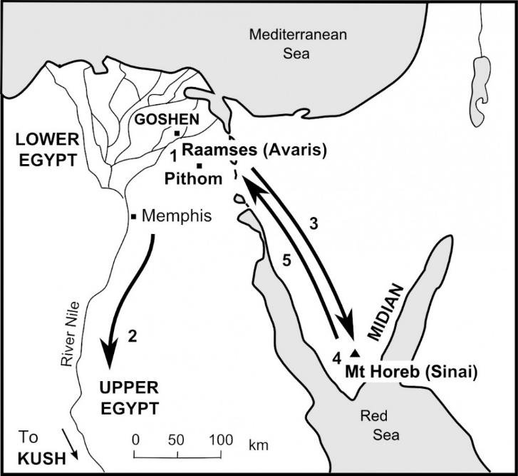

Slide 6
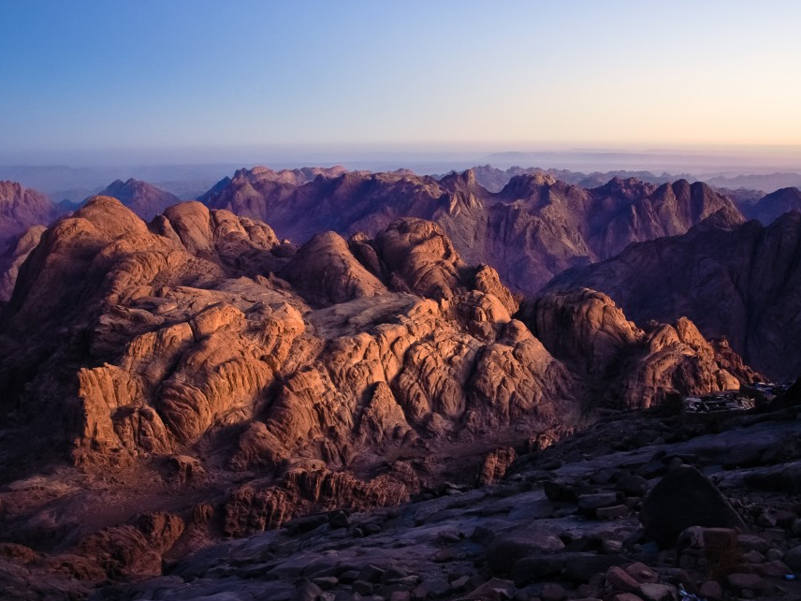

Slide 7
Now Moses was keeping the flock of his father-in-law, Jethro, the priest of Midian, and he led his flock to the west side of the wilderness and came to Horeb, the mountain of God. And the angel of the Lord appeared to him in a flame of fire out of the midst of a bush. He looked, and behold, the bush was burning, yet it was not consumed.

Slide 8
And Moses said, “I will turn aside to see this great sight, why the bush is not burned.” When the Lord saw that he turned aside to see, God called to him out of the bush, “Moses, Moses!” And he said, “Here I am.”

Slide 9
Then he said, “Do not come near; take your sandals off your feet, for the place on which you are standing is holy ground.” And he said, “I am the God of your father, the God of Abraham, the God of Isaac, and the God of Jacob.” And Moses hid his face, for he was afraid to look at God.

Slide 10
I Will Deliver My People
God’s Promise: What was God’s promise to the people? vs 7 – 10
God’s Self-Revelation: Who does God say he is? Why would this matter to Moses, the Israelites?

Slide 11
Moses Responds
1. Who Am I? (Exodus 3:11)
2. What Shall I Say to Them? (Exodus 3:13)
3. They Will Not Believe Me (Exodus 4:1)
4. I Am Not Eloquent (Exodus 4:10)
5. Send Someone Else (Exodus 4:13)

Slide 12
I Will Deliver My People
God’s Promise: What was God’s promise to the us?
Exodus | Jesus’ I Am
3:8 | John 14:6
3:14 | John 8:58
3:10 | John 10:9

