Slide 1
THE EXODUS
BE DELIVERED

Slide 2
Date | Topic | Leader
Mar 3 | Israelites' Oppression & Moses Birth | Jordan
Mar 10 | The Call of Moses | John
Mar 17 | Moses Confronts Pharaoh | John
Mar 24 | The Frist Plagues | Jordan
Mar 31 | Continuation of Plagues | John
Apr 7 | The Final Plague & Passover | Jordan
Apr 14 | Exodus & Red Sea Crossing | Jordan
Apr 21 | Songs of Deliverance & Manna | John
Apr 28 | Water from the Rock & Jethro’s Advice | Jordan
May 5 | Sinai Covenant & Ten Commandments | Jordan
May 12 | Laws & Ordinances | John
May 19 | Tabernacle Instructions | Jordan
May 26 | Golden Calf & Intercession | John

Slide 3
THE EXODUS
BE DELIVERED

Slide 4
Who is the Lord, that I should obey his voice and let Israel go? I do not know the Lord and moreover, I will not let Israel go.
Exodus 5:2

Slide 5
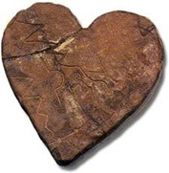
Who is this confrontation between?
What role is Moses going to play?
What is a hard heart?
Who did the hardening?
The Confrontation

Slide 6
The Ten Plagues and Pharoah’s Heart
Blood: Pharaoh’s heart “became hard” (7:22)
Frogs: Pharaoh “hardened his own heart” (8:15)
Gnats: Pharaoh’s heart “was hard” (8:19)
Flies: “Pharaoh hardened his own heart” (8:32)
Livestock die: Pharaoh’s heart “was hard” (9:7)
Boils: “The Lord hardened Pharaoh’s heart” (9:12)
Hail: Pharaoh “hardened his own heart” (9:34)
Locusts: God announces that he has “hardened Pharaoh’s heart” (10:1,10:20)
Darkness: God “hardened Pharaoh’s heart” (10:27)
Death of the firstborn: God “hardened Pharaoh’s heart” (11:10)

Slide 7
Who is this confrontation between?
What role is Moses going to play?
What is a hard heart?
Who did the hardening?
Can our hearts be hardened today?
The Confrontation

Slide 8
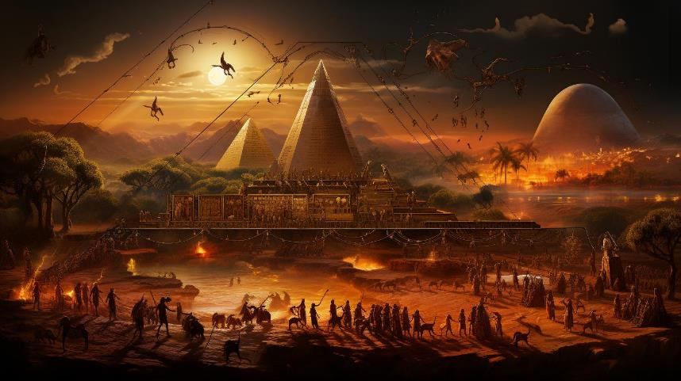
The Plagues

Slide 9
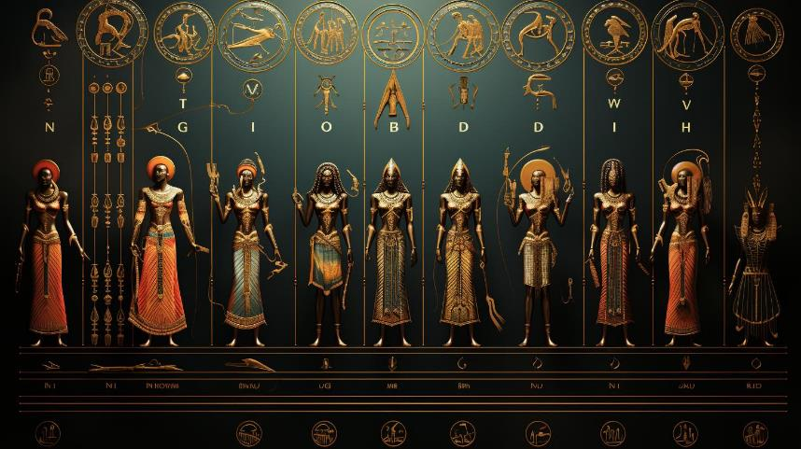
The Plagues

Slide 10
For the creation waits with eager longing for the revealing of the sons of God… that the creation itself will be set free from its bondage to corruption and obtain freedom of the glory of the children of God. For we know that the whole creation has been groaning together… we ourselves, who have the firstfruits of the Spirit, groan inwardly as we wait eagerly for adoption as sons…
Romans 8:19, 21-22, 23

Slide 11
THE EXODUS
BE DELIVERED

