Slide 1
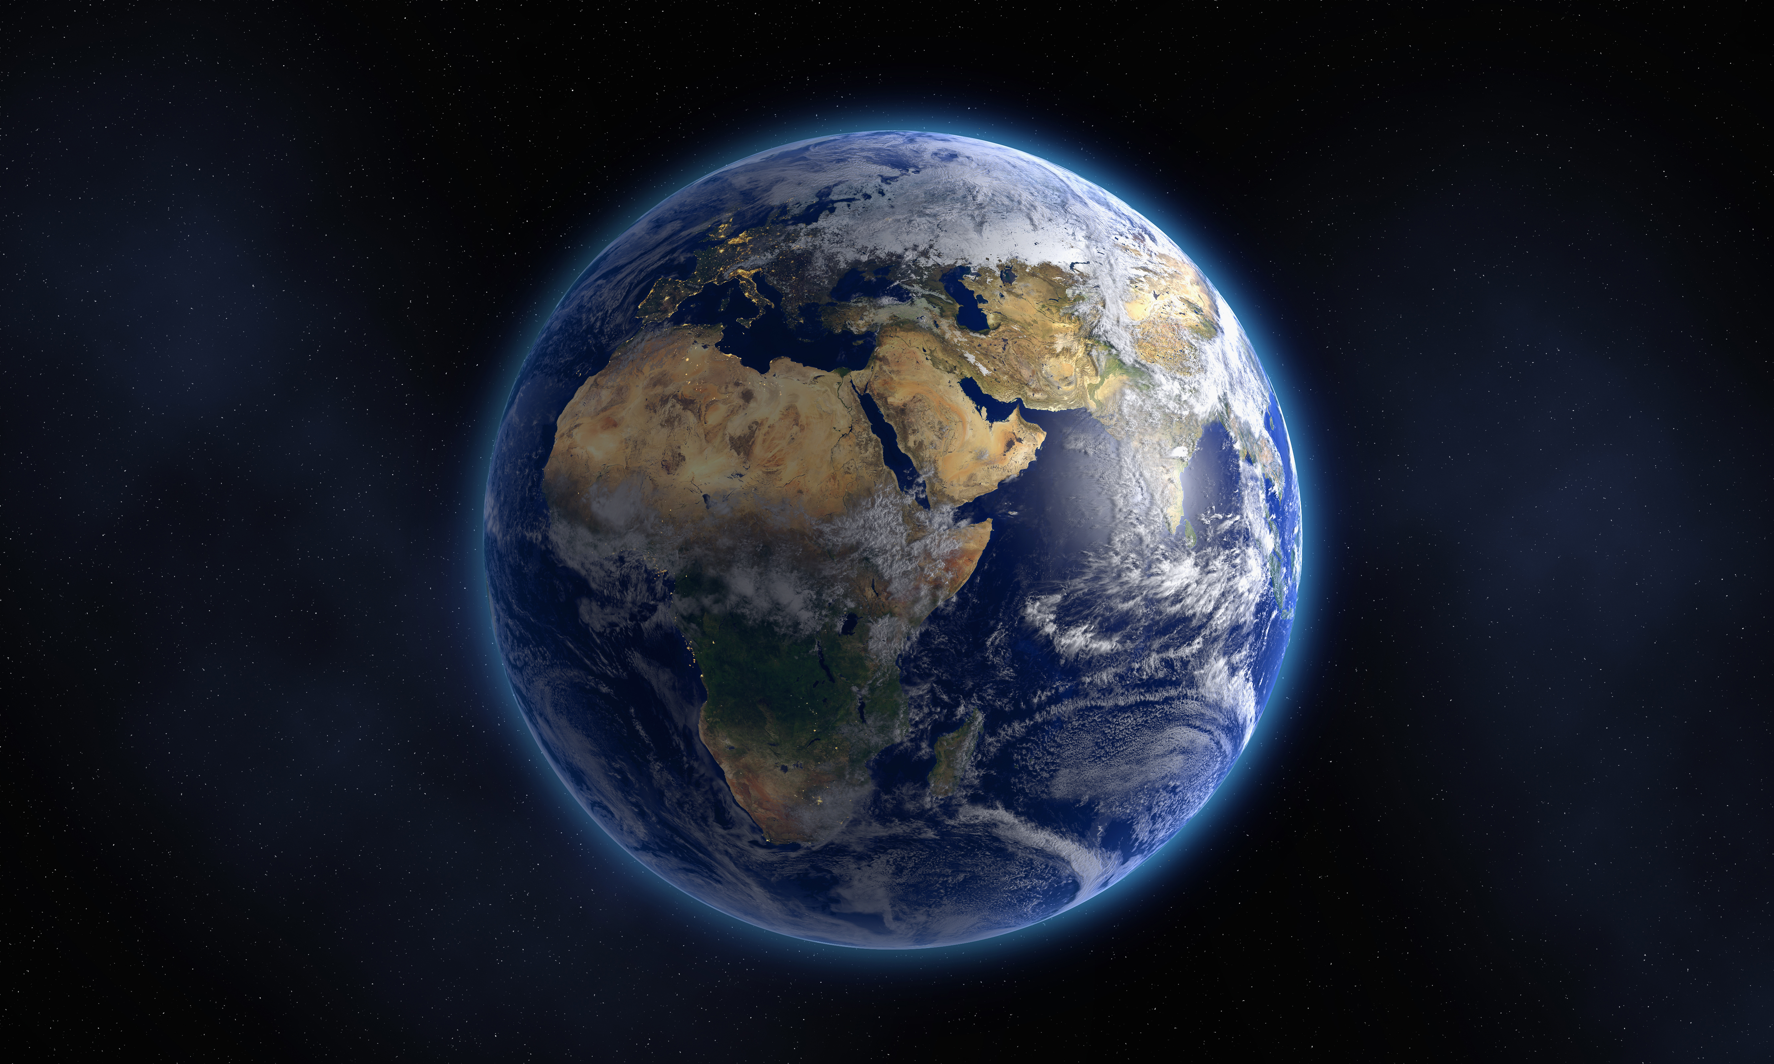
The book of genesis
A Study of the Pentateuch

Slide 2
Introduction
Genesis 1-11
God created all things and makes humans in His image to rule/subdue the world
Humans choose sin and rebellion – World spins out of control into violence and death (Darkness/Chaos/Disorder)
Leads up to the great rebellion at Babel and scattering of people
Question: What is God going to do to rescue and redeem His world?
Gen.12:1-3
THE PROMISE: Land, Nation, Name, Bless
Why? “…In you, all the families of the earth will be blessed…”
God’s plan is to rescue and bless his rebellious world through Abraham’s family.
This is why the rest of the story focuses on just one family.
Same promise spoken of by prophets – Isaiah 11 and Psalm 72
Promise will be fulfilled in the coming Messianic Kingdom.
Abraham must learn that the Great Promise, the lodestar of his life, must be fulfilled divinely and miraculously or not at all.

Slide 3
Abraham’s test
What does it mean to be tested by God?
James 1:13 – Not a temptation to fail
I Pet. 1:5-7
Proving of our faith → Praise, Glory, Honor to God
Are we also tested? If so, how?
Opportunity to demonstrate: Faith, Trust, Obedience, Submission
Notes:
James 1:13 “Let no one say when he is tempted, “I am being tempted by God”; for God cannot be tempted by evil, and He Himself does not tempt anyone.”
I Pet. 1:5-7 “…who are protected by the power of God through faith for a salvation ready to be revealed in the last time. In this you greatly rejoice, even though now for a little while, if necessary, you have been distressed by various trials, so that the proof of your faith, being more precious than gold which is perishable, even though tested by fire, may be found to result in praise and glory and honor at the revelation of Jesus Christ;…”
Abraham’s trust weighed in balance against
Common sense, human affection, lifelong ambition

Slide 4
Bible Project Test video

Slide 5
Scripture reading Genesis 22:1-19

Slide 6
Abraham’s inner struggle
What words would you use to describe Abraham’s response to God’s test?
22:2 – “…Take now ¹your son, ²your only son, ³whom you love, Isaac.
Three imperatives:
Take Isaac, Go, Offer him as a burnt offering
No indication Abraham was given any further instructions
22:3 – Seemingly perfunctory details of Abraham’s preparation
Rose early, saddled his donkey, took two young men, cut wood
Notes:
22:2 – “…Take now your son, your only son, whom you love, Isaac.
Proverbial knife twisted with each word of request
What does verse 2 immediately hyperlink us to in the NT?
Immediately see parallels to fulfillment of the garden promise
Already in Ch. 22 – God is revealing His plan to rescue/redeem man
Three imperatives:
Take Isaac,
Go,
Offer him as a burnt offering
No indication Abraham was given any further instructions
22:3 – Seemingly perfunctory details of Abraham’s preparation
Rose early, saddled his donkey, took two young men, cut wood

Slide 7
“…offer him there as a burnt offering…”
Consider the gravity of the task
The son given to Abraham was to be given back to God without reservations of any sort.
Exodus 13:11-13 – firstborn males belong to the Lord
Wasn’t enough he had to resign himself to Isaac’s death
He himself had to build the fire, bind the boy, raise the knife, look into his eyes, and plunge it into his defenseless body
Didn’t just have to suffer the loss – compelled to carry out the process
Notes:
The son given to Abraham was to be given back to God without reservations of any sort.
Exodus 13:11-13 – firstborn males belong to the Lord
“Now when the Lord brings you to the land of the Canaanite, as He swore to you and to your fathers, and gives it to you, you shall devote to the Lord the first offspring of every womb, and the first offspring of every beast that you own; the males belong to the Lord.”
Abraham – enters into promised land – offers first born son to God
Israelites – enter promised land – offer sacrifice of first born to God
Jesus on mount Calvary
Wasn’t enough he had to resign himself to Isaac’s death
He himself had to
build the fire,
bind the boy,
raise the knife,
look into his eyes,
and plunge it into his defenseless body
Didn’t just have to suffer the loss – compelled to carry out the process

Slide 8
Abraham’s obedience & trust
How does Abraham demonstrate obedience and trust in God’s command?
Response was immediate (22.3 – “…rose early in the morning…”)
Response was silent
No debate like with Ishmael – Gen. 17:18
No bargaining like with Lot – Gen. 18:22-33
Commitment to God’s will
First spoken words to Isaac: “God will provide…” – Gen. 22:8
“WE will return and worship with you…” – Gen. 22:5
Why did he say WE?
Notes:
How does Abraham demonstrate obedience and trust in God’s command?
Response was immediate (22.3 – “…rose early in the morning…”)
The bargainer falls silent
No debate like with Ishmael – Gen. 17:18
“And Abraham said to God, “Oh that Ishmael might live before You!”
No bargaining like with Lot – Gen. 18:22-33
“may the Lord not be angry, and I shall speak; suppose thirty are found there…”
Only movement – hurrying, saddling, taking, splitting, arising, going…
Commitment to plan – 22:4 “…on the third day Abraham raised his eyes and saw the place from a distance…”
in the flush of passion we can all do heroic deeds, in the heat of combat very ordinary people can do extraordinary things. Abraham’s test wasn’t over in a flash – he had three long days to talk himself out of obeying; three long days to come up with a good reason why this shouldn’t be obeyed. To his everlasting credit, the delay between the order and the execution made no dent in his willingness to obey…”
First spoken words to Isaac: “God will provide…” – Gen. 22:8
Confident expression of Abraham’s trust in God
“WE will return and worship with you…” – Gen. 22:5
Why did Abraham say WE?

Slide 9
Abraham’s unwavering faith
Hebrews 11:17-19 – “By faith Abraham, when he was tested, offered up Isaac, and he who had received the promises was offering up his only begotten son; it was he to whom it was said, “In Isaac your descendants shall be called.” He considered that God is able to raise people even from the dead, from which he also received him back as a type.”
Why did Abraham walk confidently to the altar of sacrifice with his son?
Abraham must learn that the Great Promise, the lodestar of his life, must be fulfilled divinely and miraculously or not at all.
Notes:
Hebrews 11:17-19 – “By faith Abraham, when he was tested, offered up Isaac, and he who had received the promises was offering up his only begotten son; it was he to whom it was said, “In Isaac your descendants shall be called.” He considered that God is able to raise people even from the dead, from which he also received him back as a type.”
Why did Abraham walk confidently to the altar of sacrifice with his son?
He believed in God’s power to resurrect him from the dead!
Abraham must learn that the Great Promise, the lodestar of his life, must be fulfilled divinely and miraculously or not at all.

Slide 10
unwavering faith in the resurrection
Can you relate to situations in your life where obedience to God’s will require great trust?
Matt. 16:24 – “Then Jesus said to His disciples, “Whoever wants to be my disciple must deny themselves and take up their cross and follow Me.”
Phil. 3:10-11 – “…that I may know Him and the power of His resurrection and the fellowship of His sufferings, being conformed to His death; in order that I may attain to the resurrection from the dead…”
Romans 6:4 – “We were therefore buried with him through baptism into death in order that, just as Christ was raised from the dead through the glory of the Father, we too may live a new life.”
Notes:
Can you relate to situations in your life where obedience to God’s will require great trust?
Consider –
We are told to bear our cross
Matt. 16:24 – “Then Jesus said to His disciples, “Whoever wants to be my disciple must deny themselves and take up their cross and follow Me.”
What does that mean?
We march to our death IN TOTAL ASSURANCE OF FAITH that God will resurrect us from the dead.
Phil. 3:10-11 – “…that I may know Him and the power of His resurrection and the fellowship of His sufferings, being conformed to His death; in order that I may attain to the resurrection from the dead…”
A NEW LIFE!
Romans 6:4 – “We were therefore buried with him through baptism into death in order that, just as Christ was raised from the dead through the glory of the Father, we too may live a new life.”

Slide 11
How does this story foreshadow god’s plan for redemption through Christ?
Son of Promise
Gen. 17:19 “Sarah your wife will bear you a son … and I will establish My covenant with him for an everlasting covenant for his descendants after him.”
Matt. 1:21 “She will give birth to a son, and you are to give him the name Jesus, because He will save His people from their sins.”
Only Son
Gen. 22:2 “Then God said, ‘Take your son, your only son, whom you love – Isaac”
John 3:16 “For God so loved the world that He gave His only begotten Son that whoever believes in Him should not perish but have everlasting life.”

Slide 12
How does this story foreshadow god’s plan for redemption through Christ?
Willing Sacrifice
Gen. 22:6-8 “…God Himself will provide the lamb for the burnt offering, my son. And the two of them went on together…”
Phil. 2:8 “And being found in appearance as a man, he humbled Himself by becoming obedient to death – even death on a cross!”
Mount Moriah
Gen. 22:2 “..go to the land of Moriah..”
II Chron. 3:1 “..Then Solomon began to build the house of the Lord in Jerusalem on Mount Moriah…”
John 19:20 “…for the place where Jesus was crucified was near the city”

Slide 13
How does this story foreshadow god’s plan for redemption through Christ?
Carrying the Wood
Gen. 22:6 “..Abraham took the wood of the burnt offering and laid it on Isaac his son… so the two of them walked on together…”
John 19:17 “Carrying His own cross, He went out to the place of the Skull (Which is called in Hebrew Golgotha)…”
Two Men Accompany
Gen. 22:3 “..took two of his young men with him”
John 19:18 “..there they crucified Him, and with Him two other men, one on either side, and Jesus in between…”

Slide 14
How does this story foreshadow god’s plan for redemption through Christ?
Substitute Sacrifice
22:13 “…Abraham raised his eyes and looked, and behold, behind him a ram…”
Rom. 5:8 “But God demonstrates His own love for us in this; While we were still sinners, Christ died for us…”
Thicket/Thorns
Gen. 22:13 “…ram caught in thicket..”
Matt. 27:29 “and after twisting together a crown of thorns, they put it on His head…”

Slide 15
Timeline of genesis 1-12
Creation
Unknown - ~ 4000 BC
The Garden of Eden
Unknown to ~ 4000 BC
The Fall of Man
Unknown - ~ 4000 BC
Cain Kills Abel
~ 4000 – 3870 BC
Adam to Noah
~ 3870 – 2814 BC
The Great Flood
~ 2214 BC
Covenant Rainbow
Tower of Babel
Abram Born
~ 2000 BC
Notes:
Genesis 1-11 – God & the World
2,000 years of history
Genesis 12-50 – God & Abraham’s Family
Approx. 200 years
God’s orderly creation – Climax in man
Perfect (holy), Relationship, Purpose
Disintegrating work of sin – Anti-climax in corrupt world of flood and babel

Slide 16
Genesis: Major class themes
God is omnipotent, omnipresent, and omniscient.
God created the world and all its hosts – it was very good.
Mankind is the image bearer of God, blessed and imbued with divine purpose.
Man’s sin in the garden and every sin thereafter separates him from God (death) and creates disorder which is in opposition to the blessed and holy purpose of God’s creation.
The promise to Abraham reorients mankind back to the original garden blessing, relationship, and purpose which is fulfilled in Christ Jesus.
Abraham, landless and childless; Isaac, bound and deceived; Jacob, blessed but grief stricken; and Joseph, betrayed and imprisoned, must learn that the Great Promise, the lodestar of their lives, must be fulfilled divinely and miraculously or not at all.

Slide 17
Abraham’s promise Genesis 12:1-3
“Now the Lord said to Abram,
“Go forth from your country,
and from your relatives
and from your father’s house,
to the land which I will show you;
And I will make you a great nation,
and I will bless you,
and make your name great;
and so you shall be a blessing;
and I will bless those who bless you,
and the one who curses you I will curse.
And in you all the families of the earth will be blessed.”
Notes:
Genealogy of Abraham
Adam → Seth → Enosh → Kenan (Cainan) → Mahalalel → Jared → Enoch → Methuselah → Lamech → Noah → Shem → Arphaxed → Shelah → Eber → Peleg → Reu → Serug → Nahor → Terah → Abram
“from your fathers house…”
Joshua Thus says the Lord, the God of Israel, ‘From ancient times your fathers lived beyond the River, namely, Terah, the father of Abraham and the father of Nahor, and they served other gods…”

